Slide 1
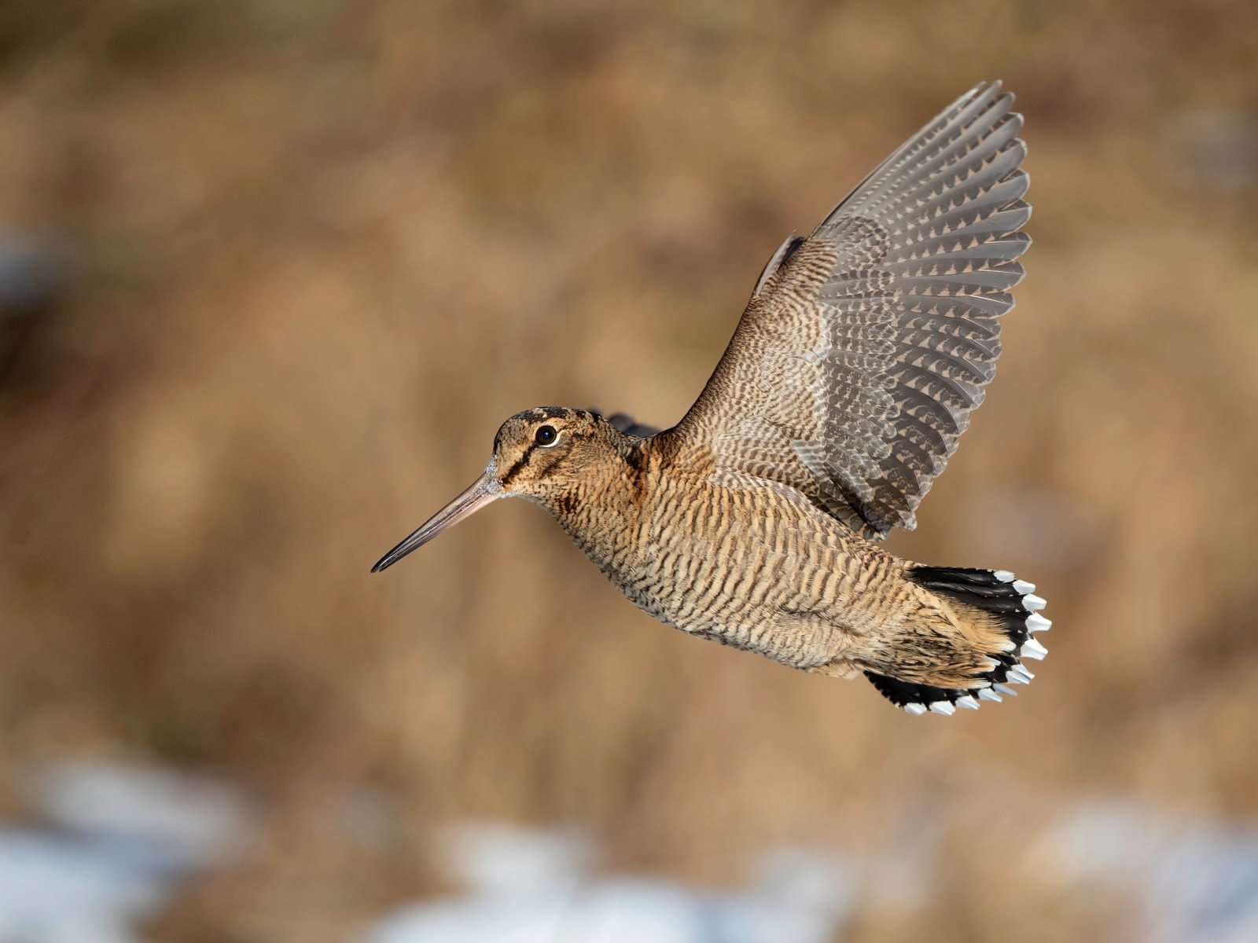
What proportion of woodcocks shot in Switzerland are local birds?
Pierre Mollet
Martin Grüebler
Steffen Oppel
Elizabeth Yohannes
Gilberto Pasinelli

Slide 2
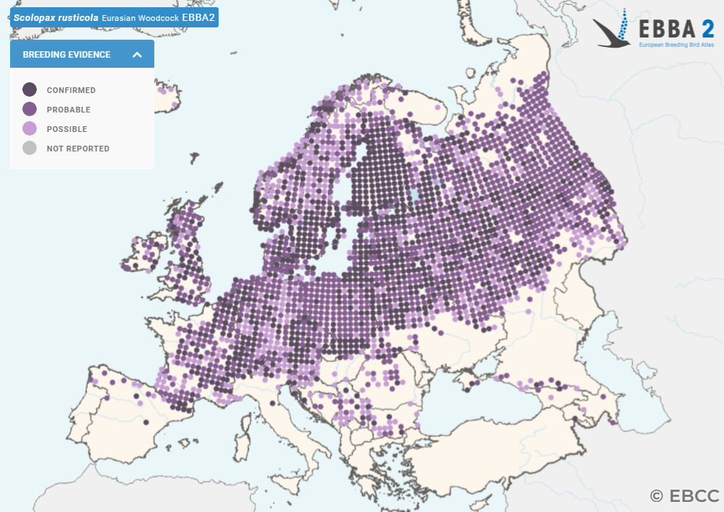
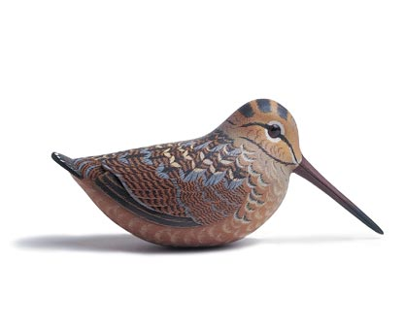
Status of woodcocks in Europe

Slide 3
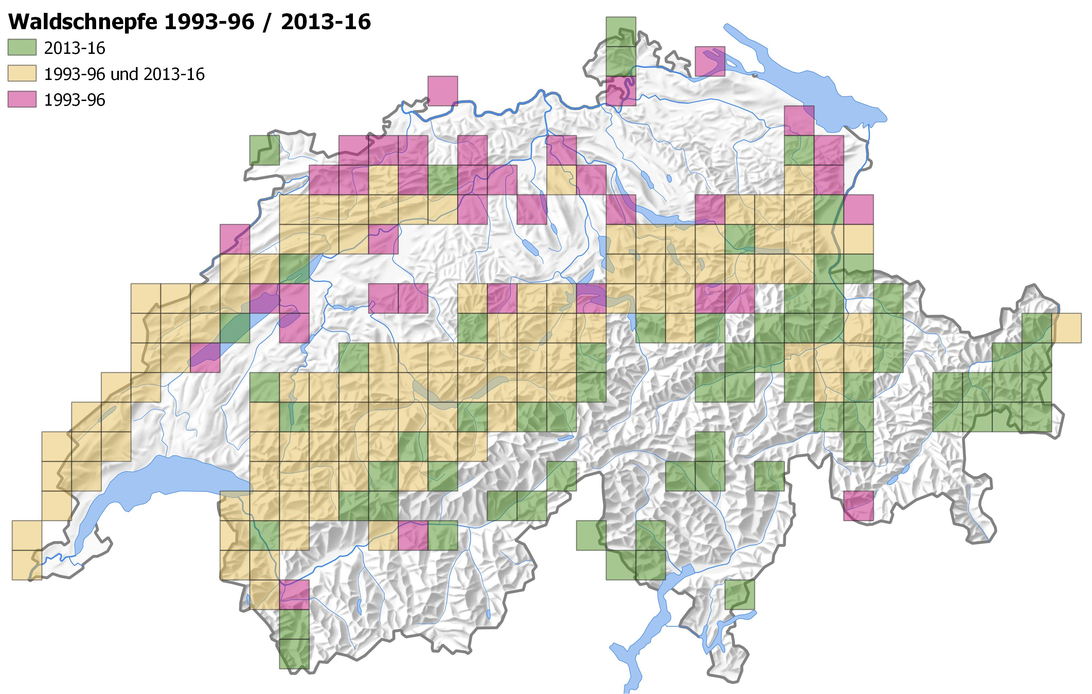
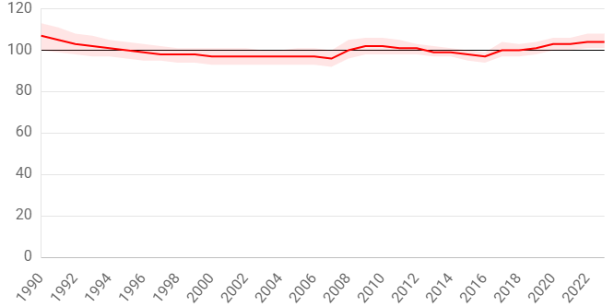
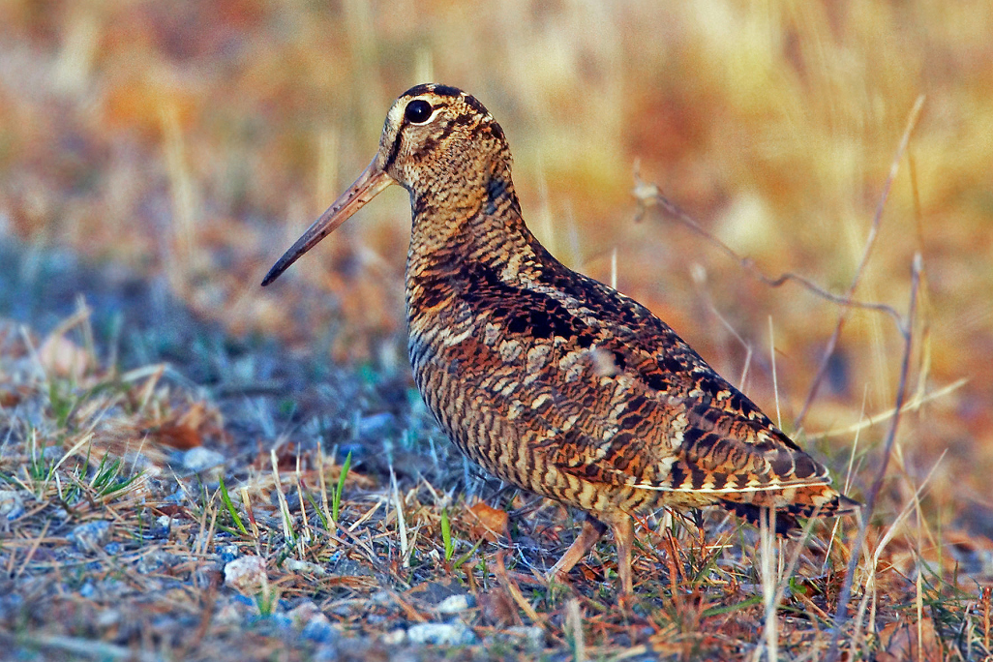
Status of woodcocks in Switzerland
breeding population size 1000 – 4000 pairs
woodcock breeding population more or less stable, but vanished from lowlands

Slide 4
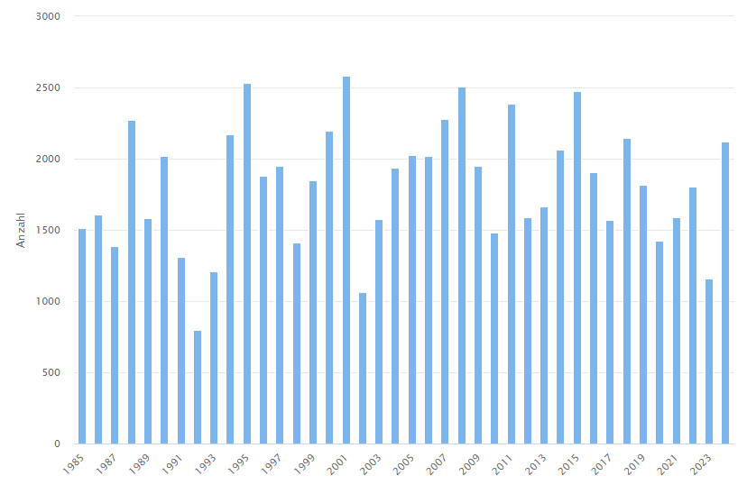
Woodcock hunting in Switzerland
woodcocks are shot in Switzerland for ‘sport’
annual harvest on average 1820 individuals – unlikely that only local birds get shot
Number of woodcocks shot per year in Switzerland

Slide 5
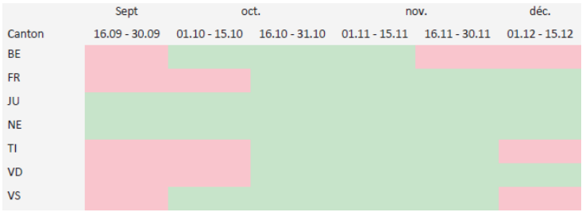
Woodcock hunting in Switzerland
hunting season in Switzerland from 16th September to 15th December
regional variation by canton (and recent changes)

Slide 6
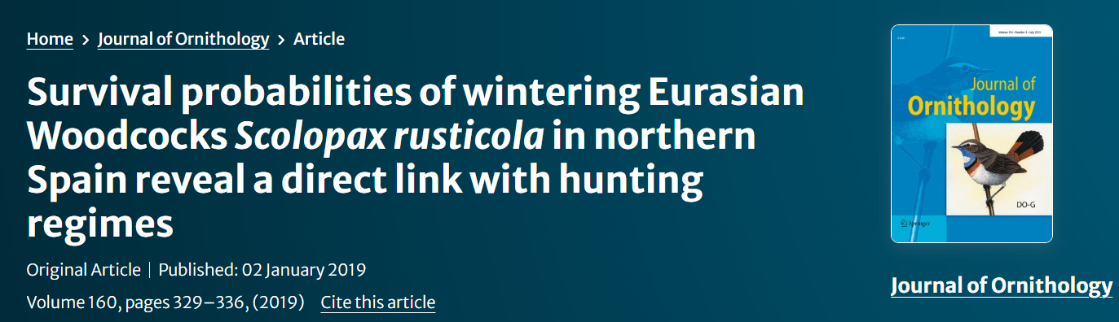
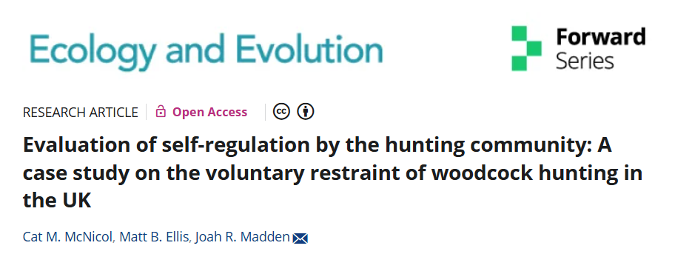
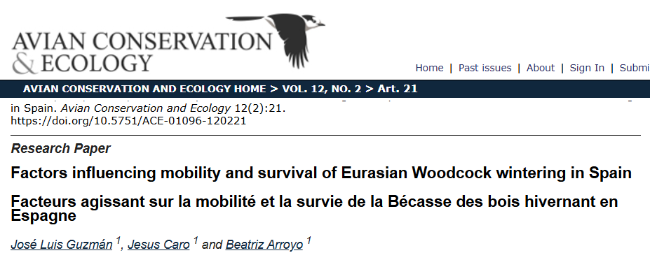
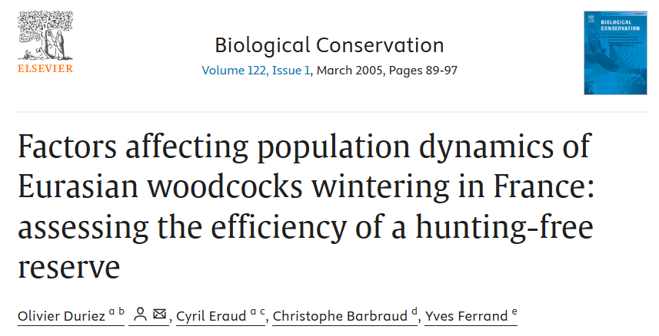
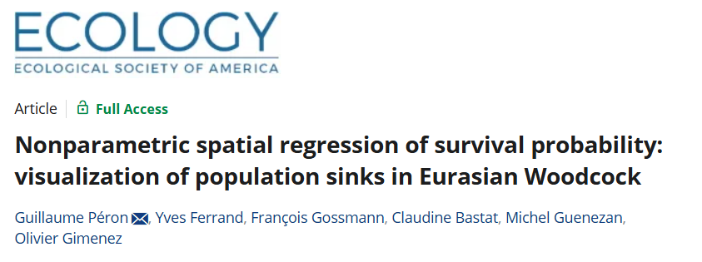
Hunting causes mortality and population declines
evidence from other countries that hunting effort reduces survival
populations in France and Spain decreasing due to unsustainable hunting levels

Slide 7
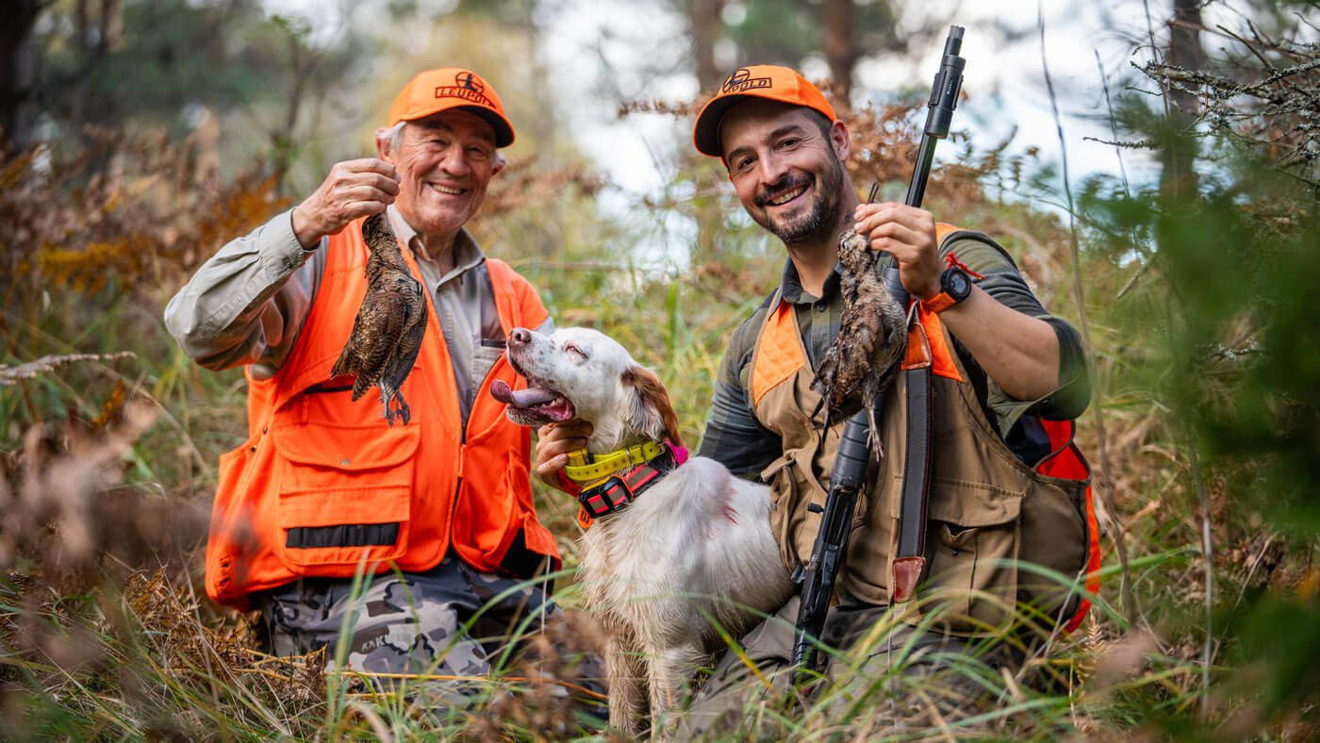
How does hunting affect woodcocks in Switzerland?
When do Swiss woodcocks depart from Switzerland?
What proportion of shot woodcocks are of local origin?

Slide 8
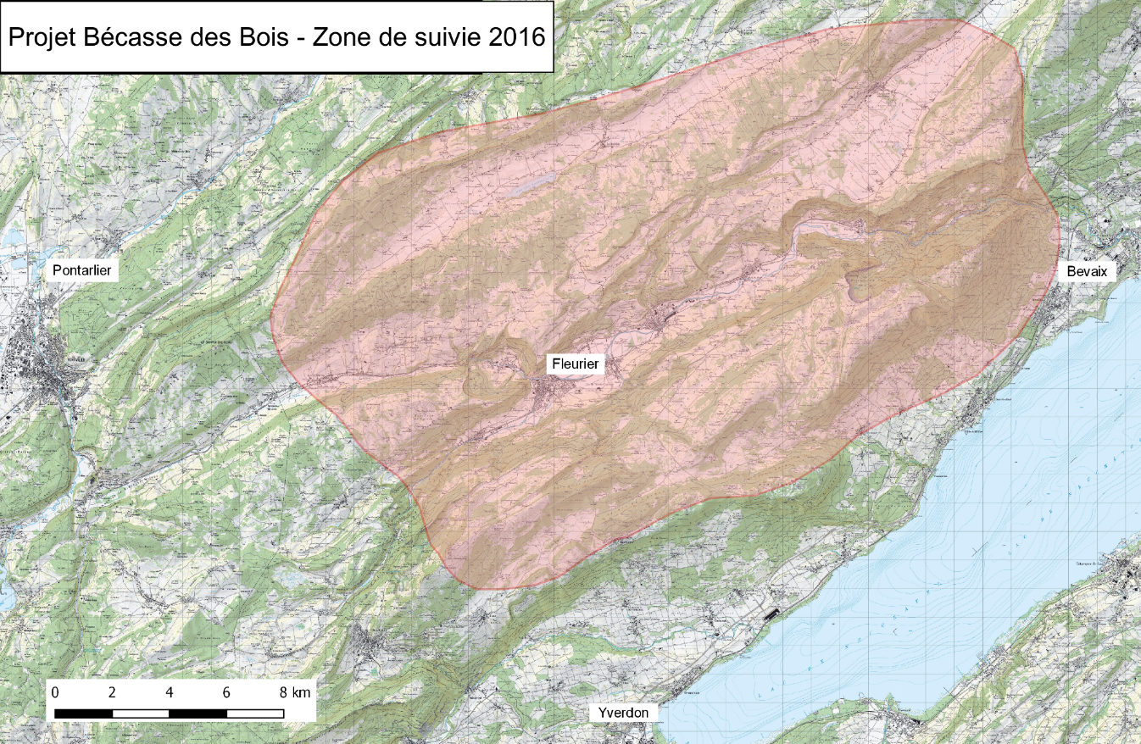
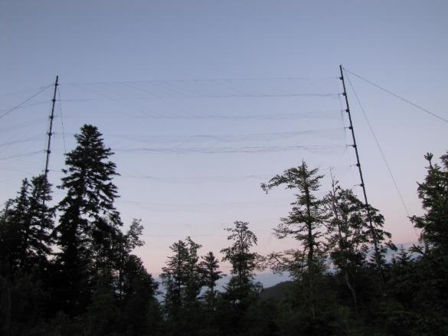
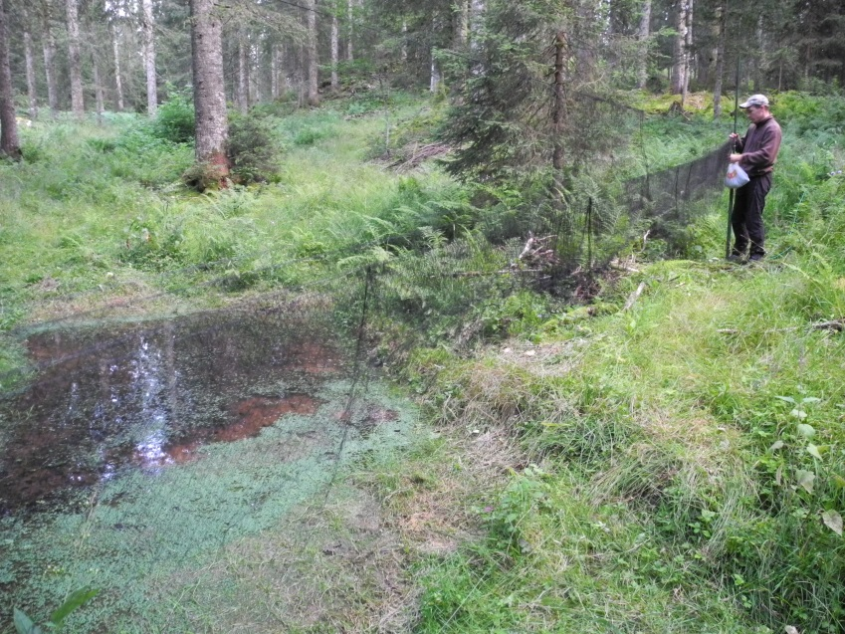
Field data collection 2005 – 2018 in Jura
captured birds with mistnets, handnets, and spotlights ….
ringed a total of 472 individual woodcocks

Slide 9
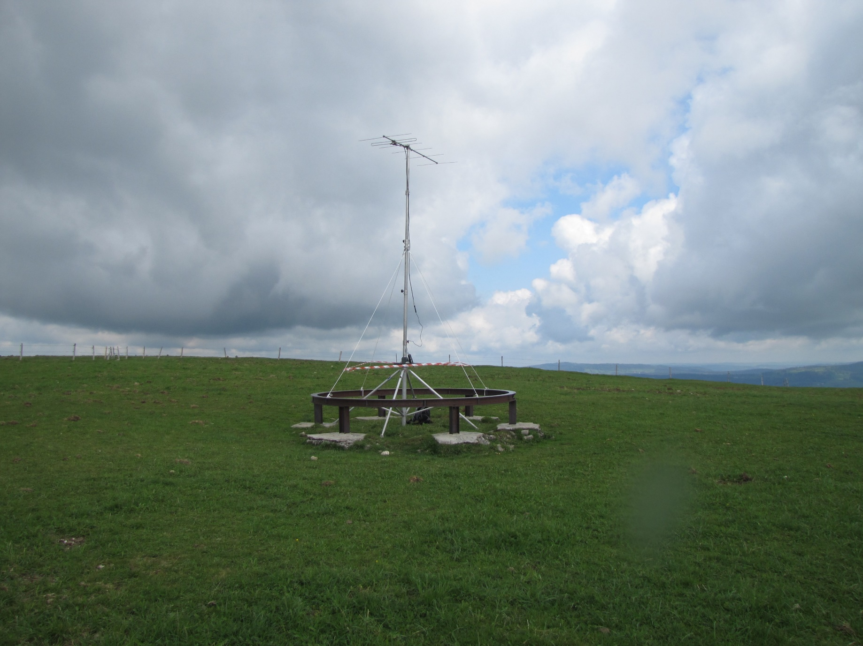
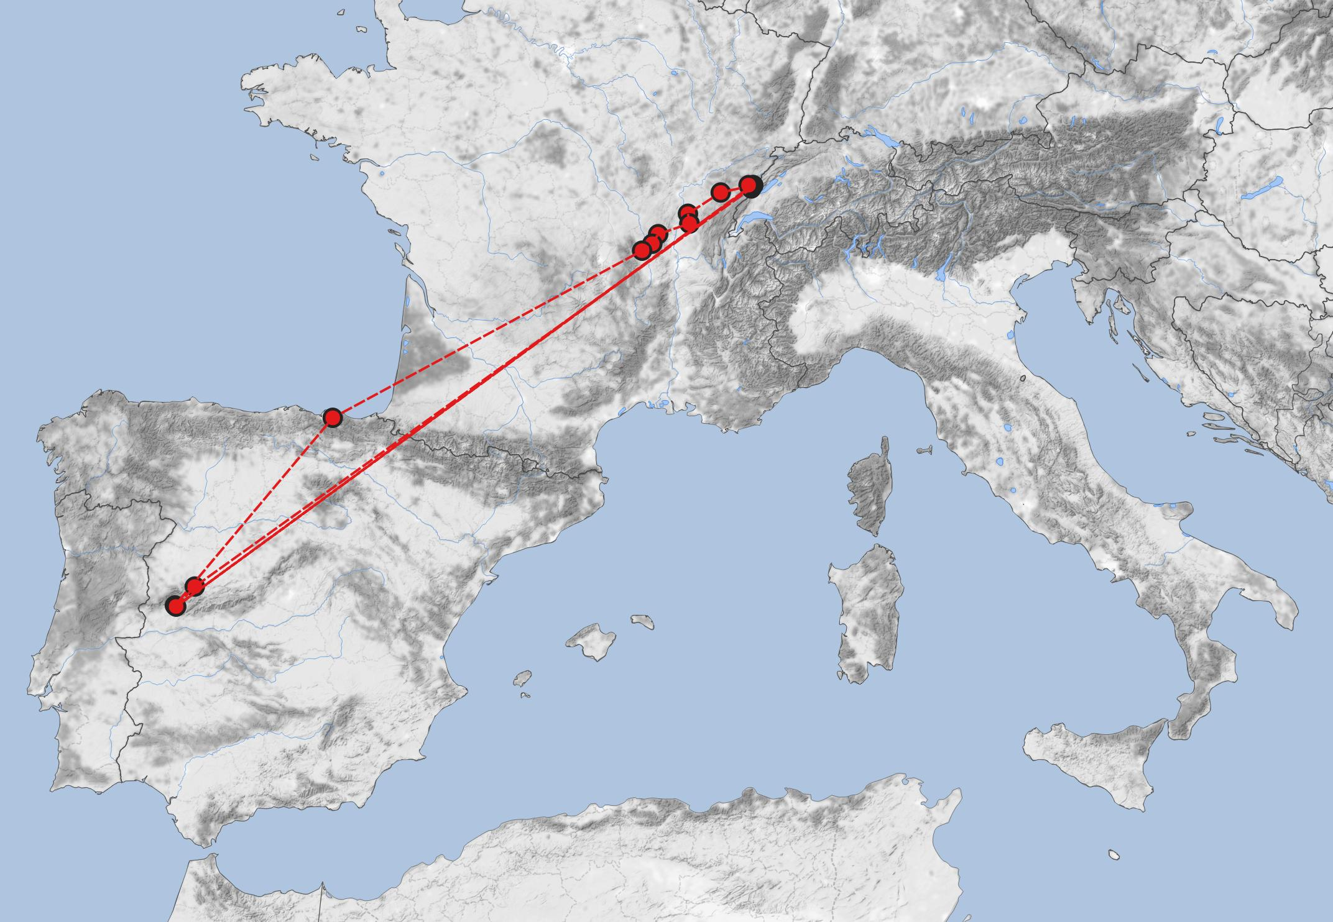
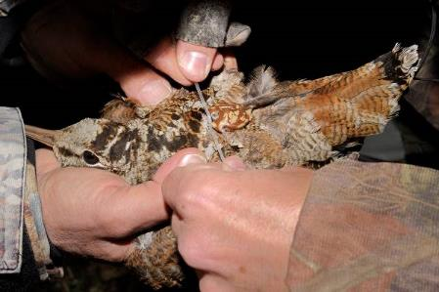
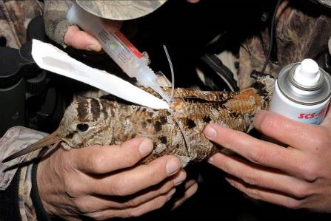
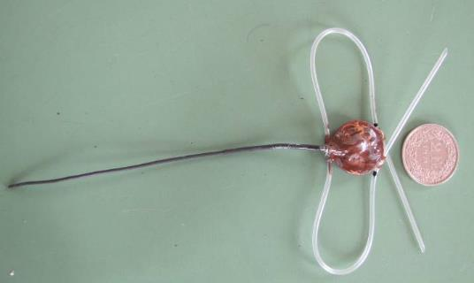
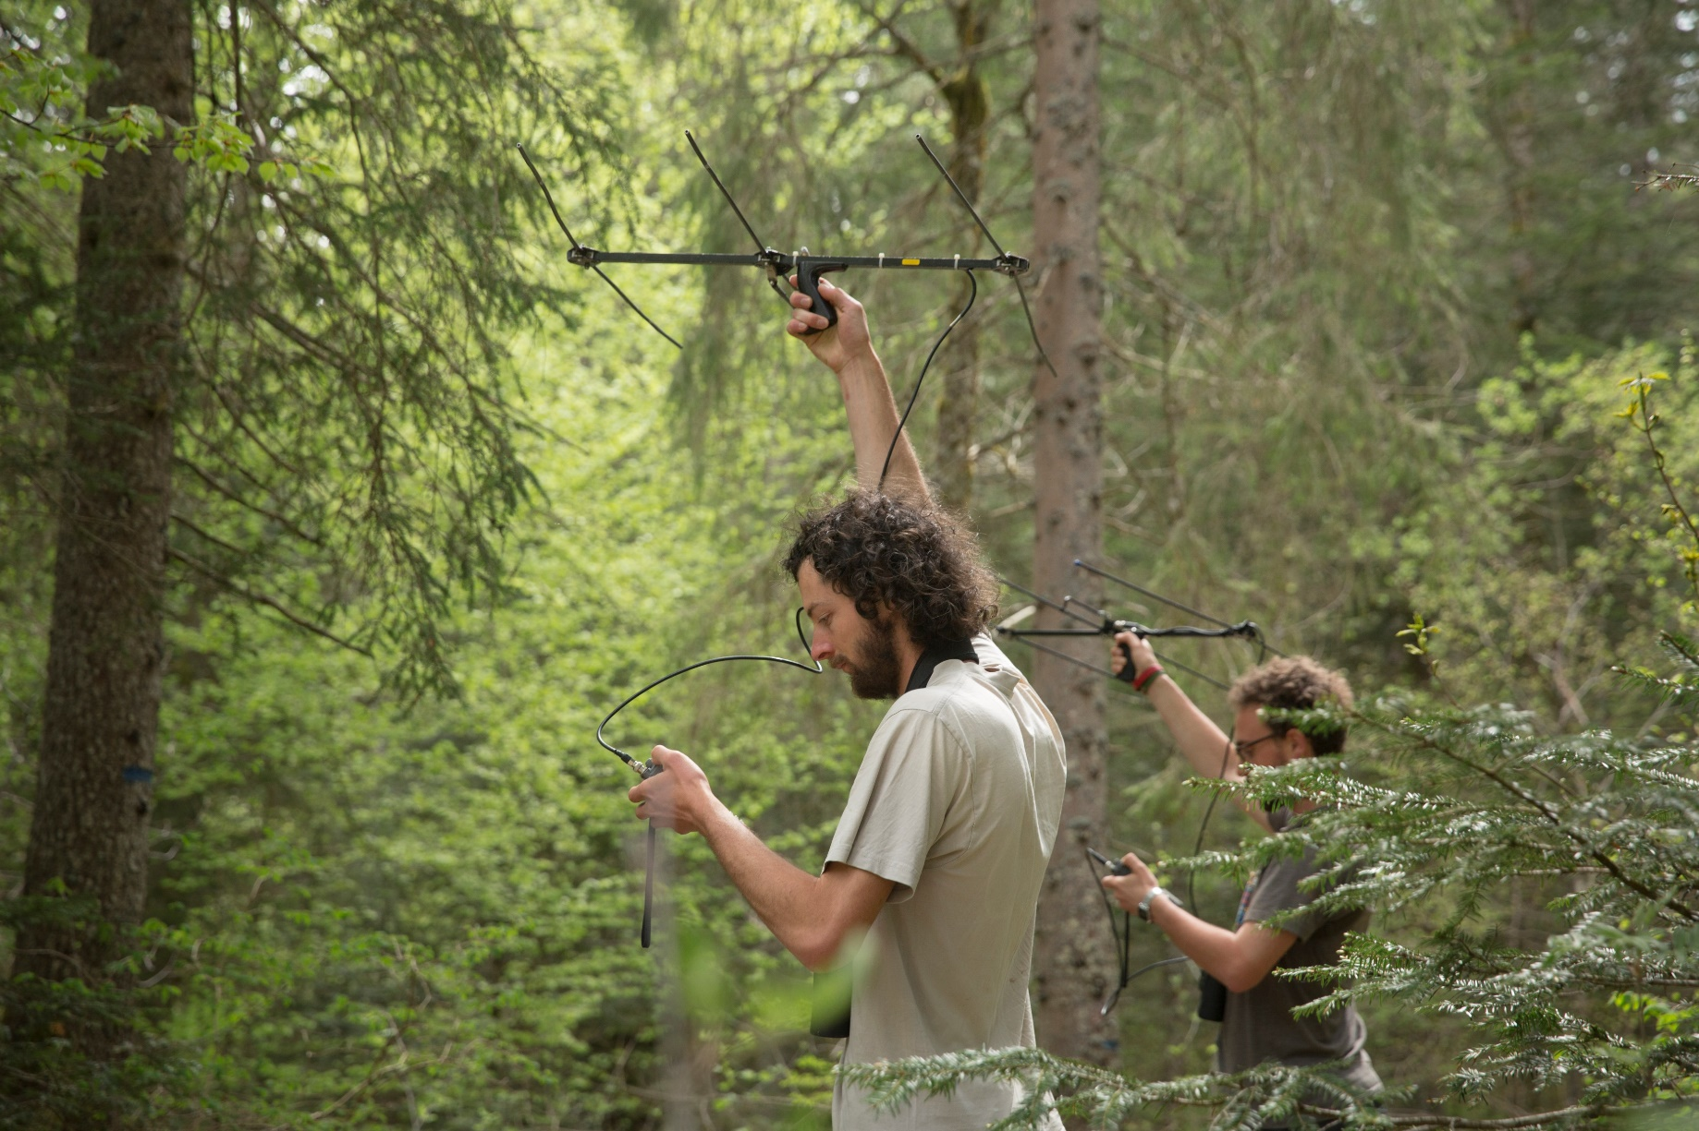
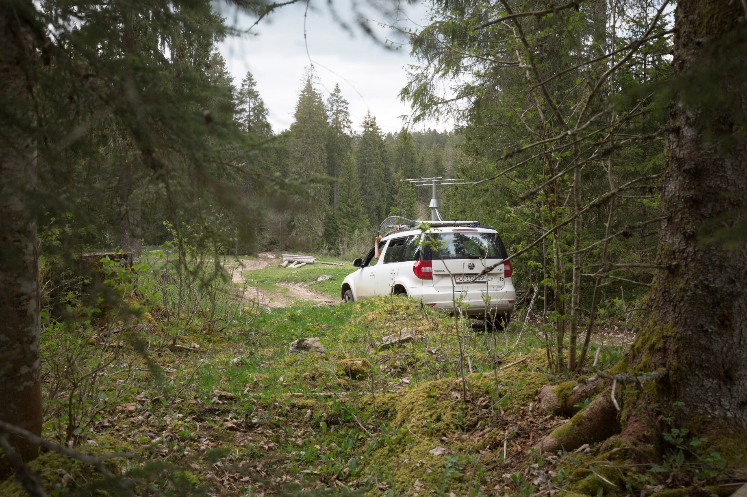
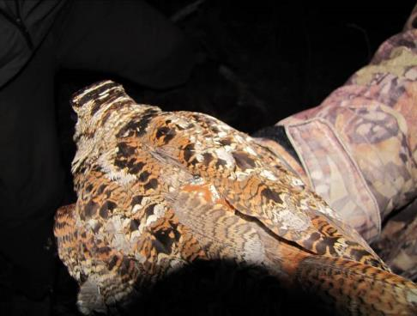
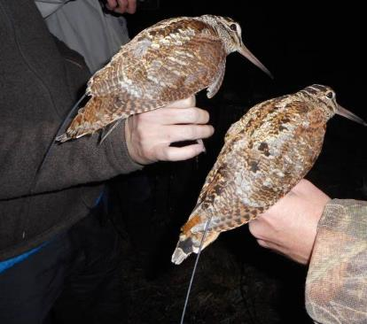
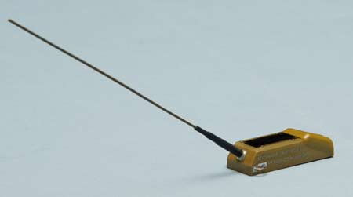
Telemetry of woodcocks
attached two types of transmitters to birds (VHF and satellite)
weekly efforts to relocate tagged birds by VHF
satellite telemetry also provides data on migration
1.7.2016 - 1.11.2016
2.7.2017 – 24.10.2017
17.7.2018 – 28.7.2018
3.11.2016
12.11.2016
19.11.2016 – 19.2.2017
6.11.2017 – 27.2.2018

Slide 10
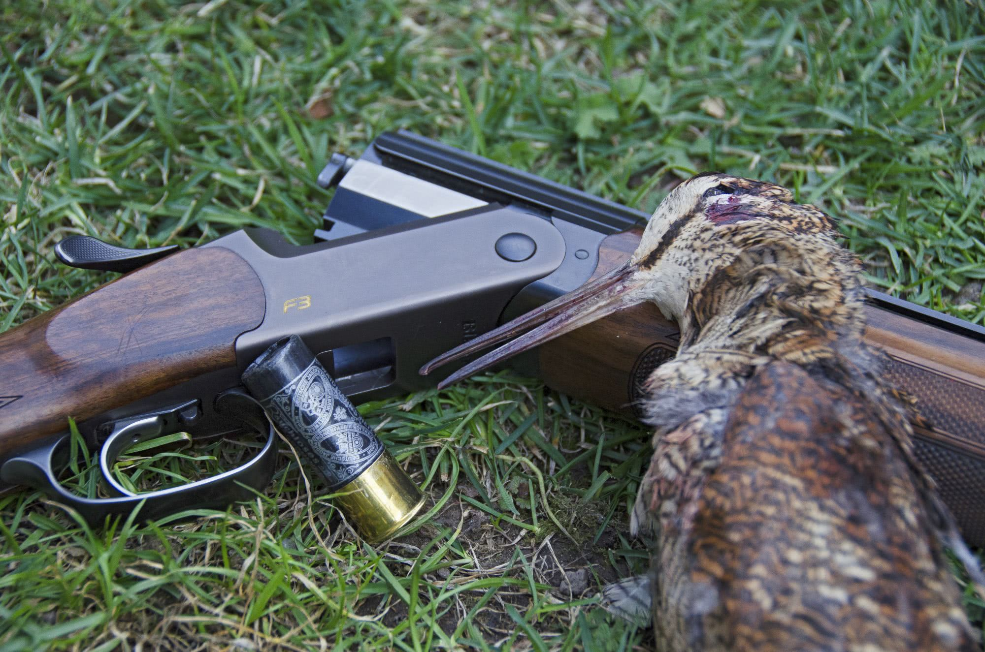
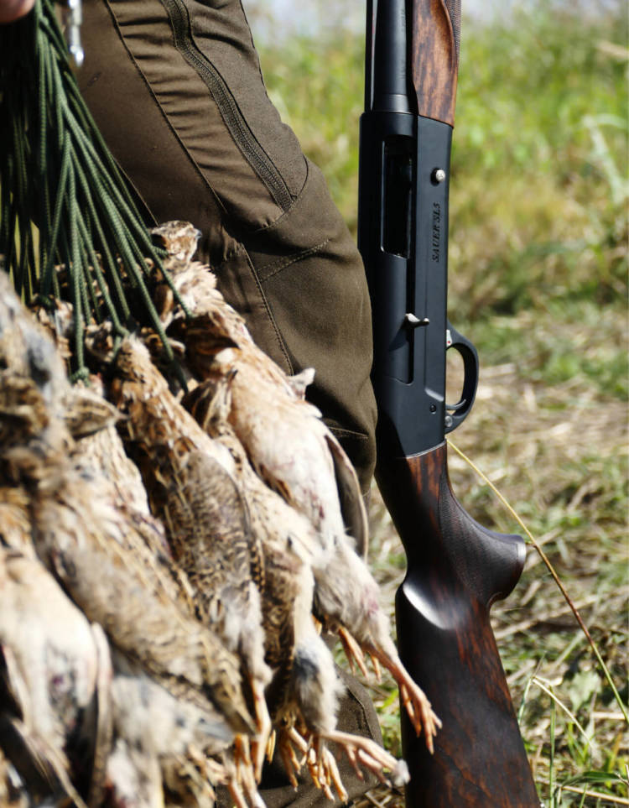
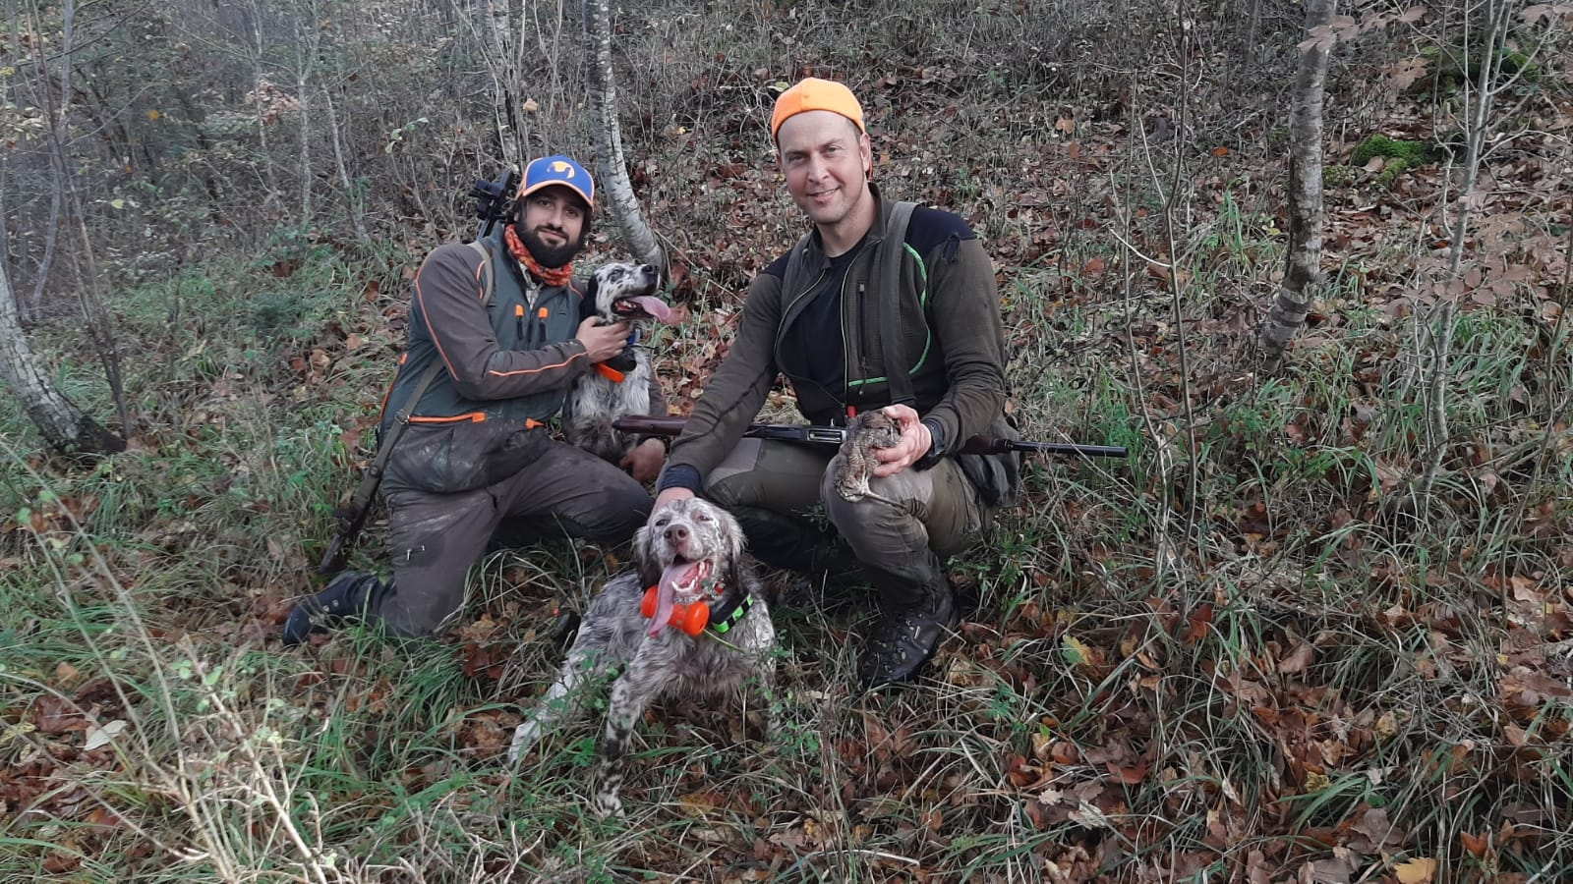
Feather collection of woodcocks
collected feathers of 72 woodcocks caught during breeding season (known origin)
requested hunters to provide wing feathers from 2013 – 2017 (n = 842)
analysed hydrogen isotope ratios in feathers

Slide 11
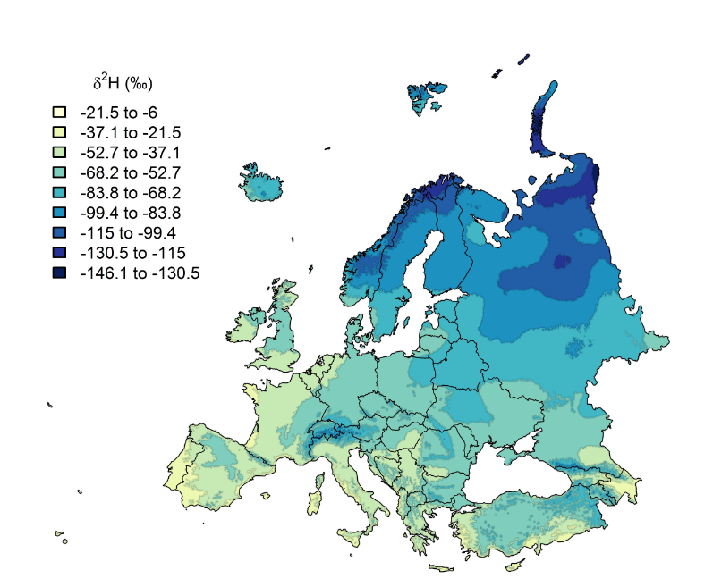
Background on geographic assignment with isotopes
geographic patterns of isotope ratios in rainwater due to circulation processes
heavy isotope rains out -> higher elevations and more continental areas usually depleted in ²H_{rain} (more negative hydrogen isotope ratio δ²H_{rain})
this geographic pattern can potentially be used to infer origins of birds

Slide 12
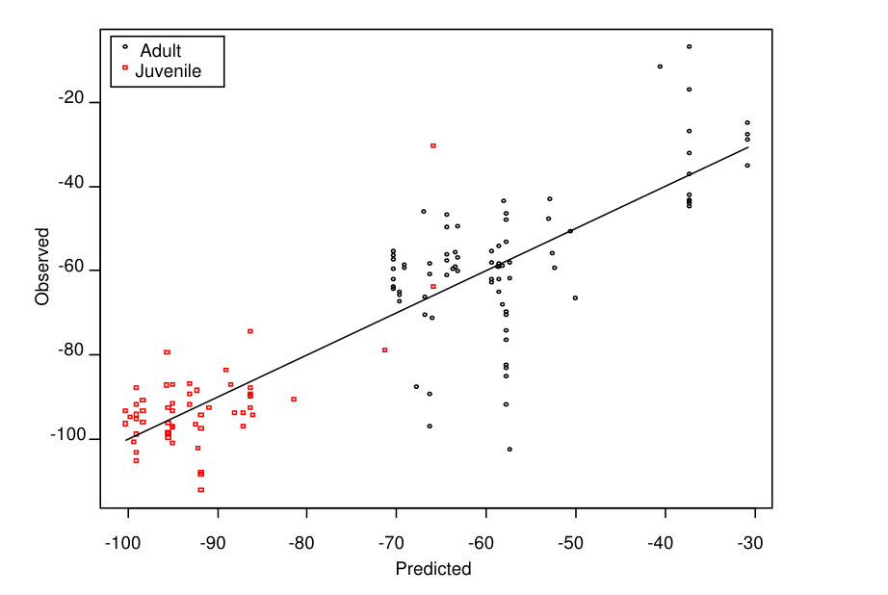
Limitations of geographic assignment
δ²H_{rain} does not necessarily reflect the dietary source for birds
fractionation between diet and feather leads to depletion of δ²H_{feather}

Slide 13
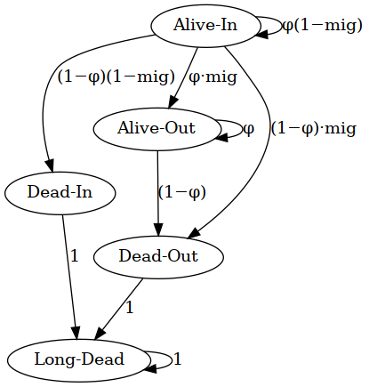
Model to estimate departure timing
estimated weekly presence in study area with a multi-event model
birds could be alive inside or outside study area, or dead inside or outside
detection probability differed between marks (ring, VHF, satellite tag)

Slide 14
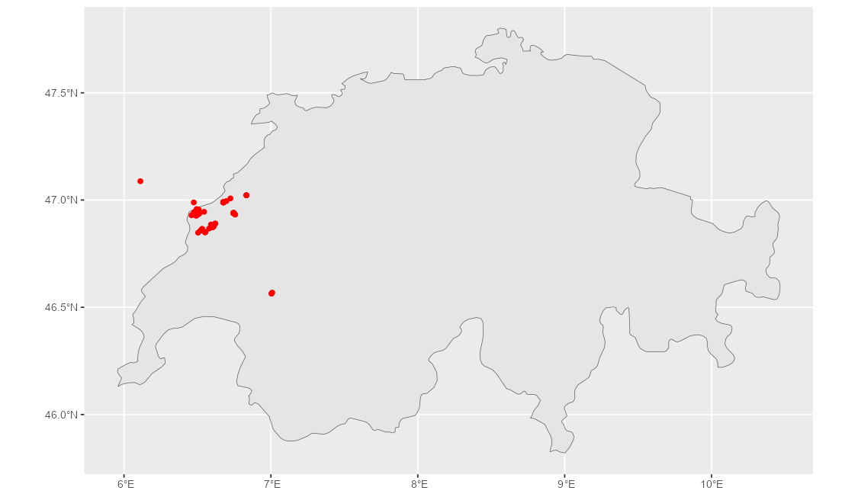
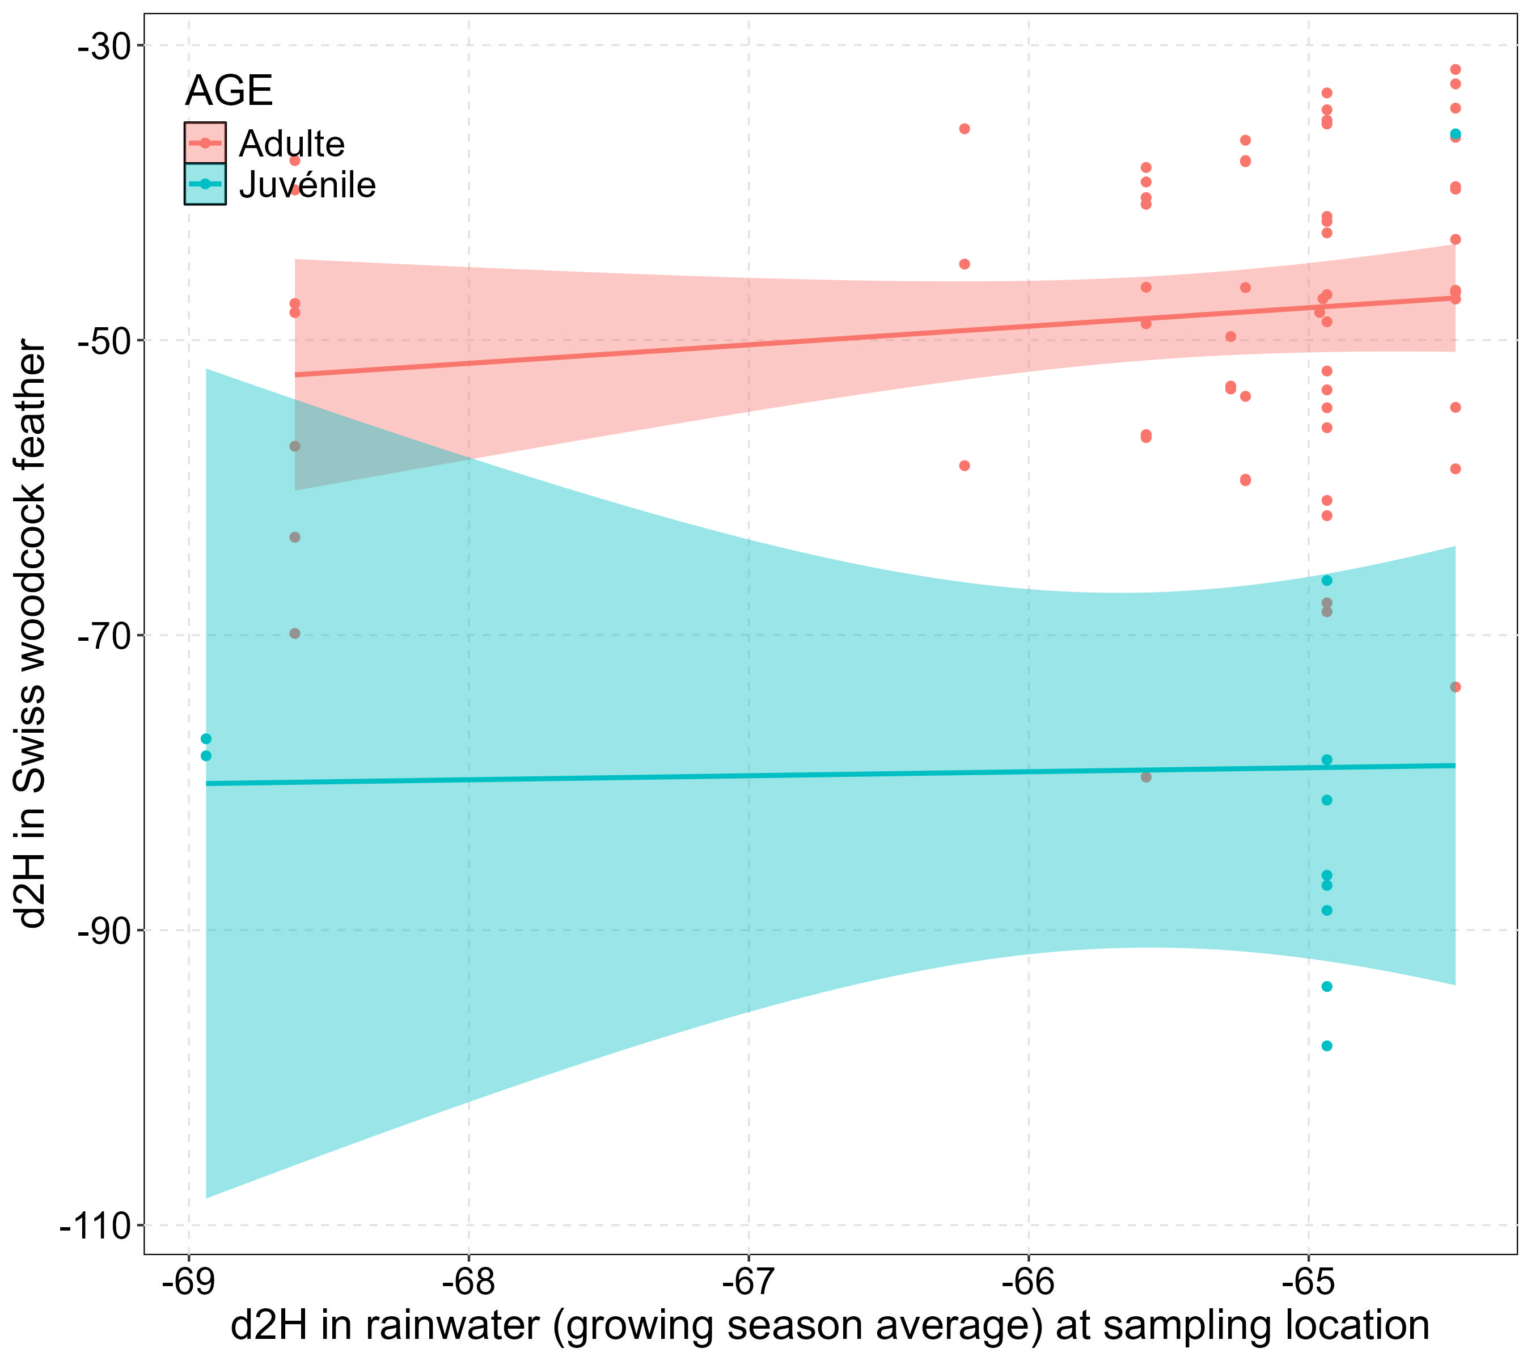
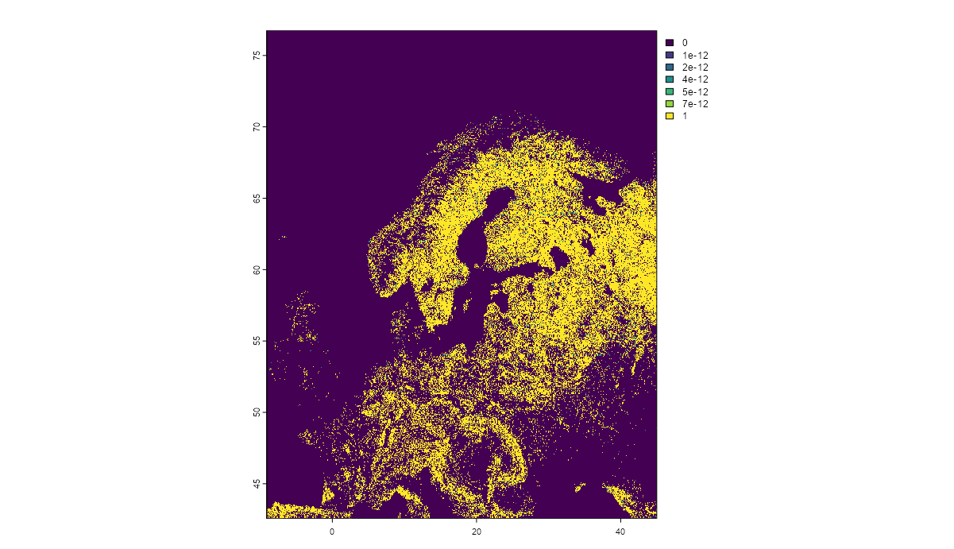
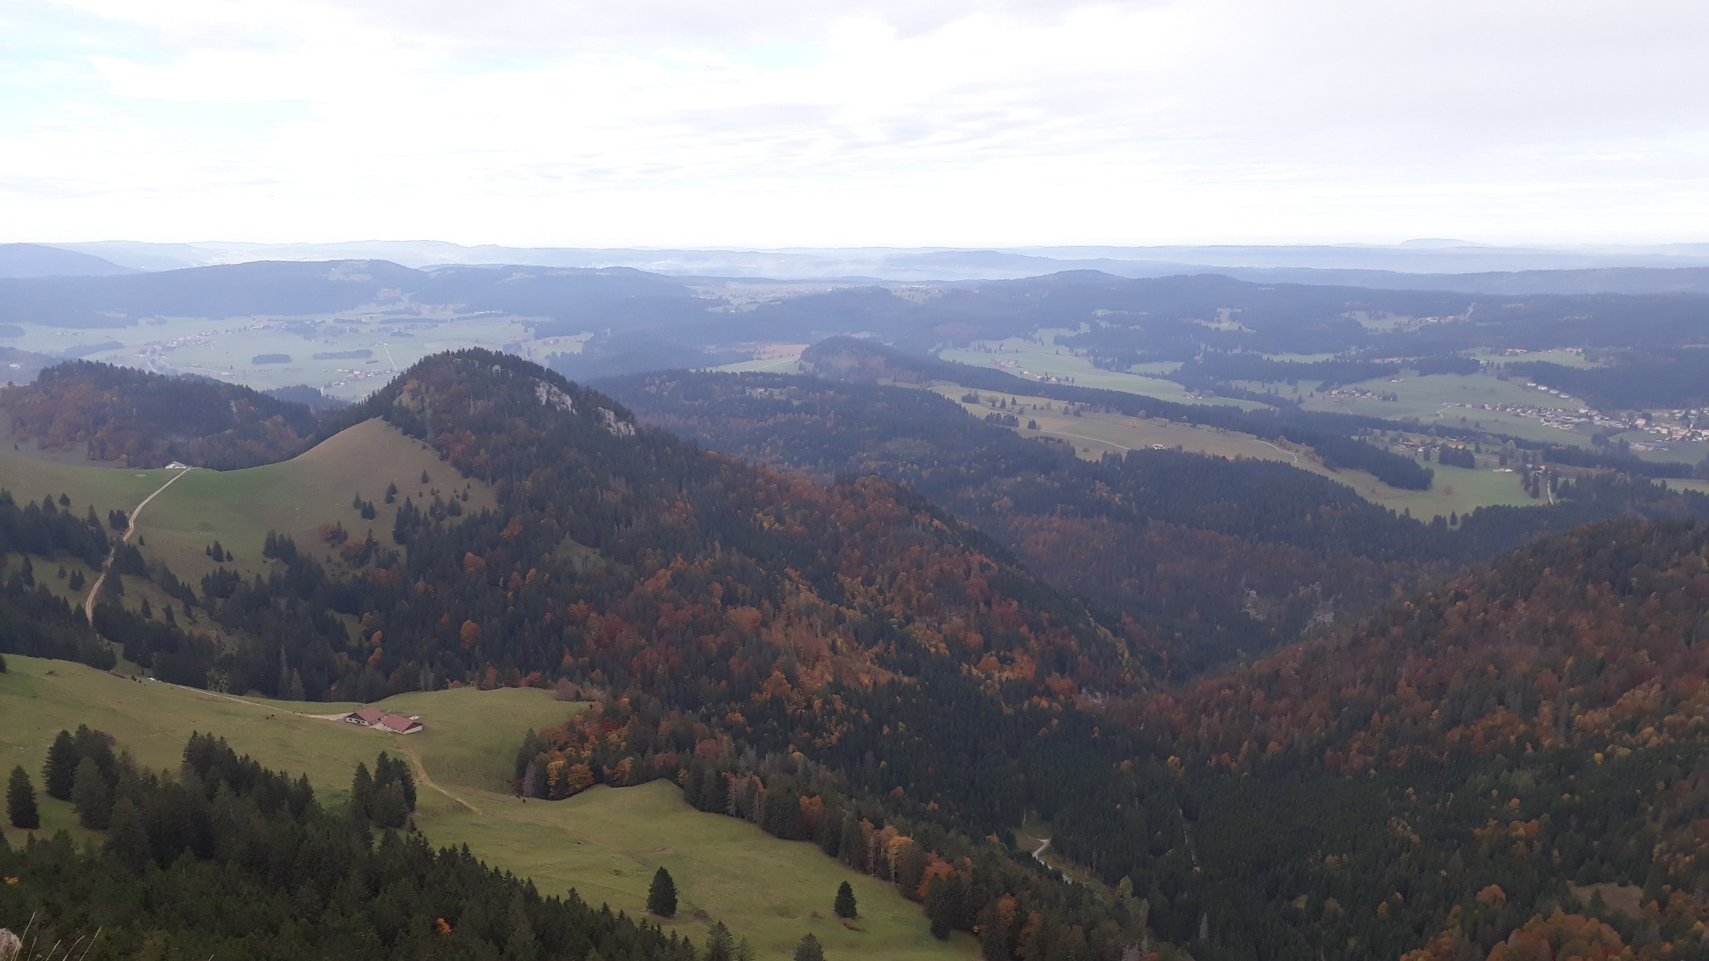
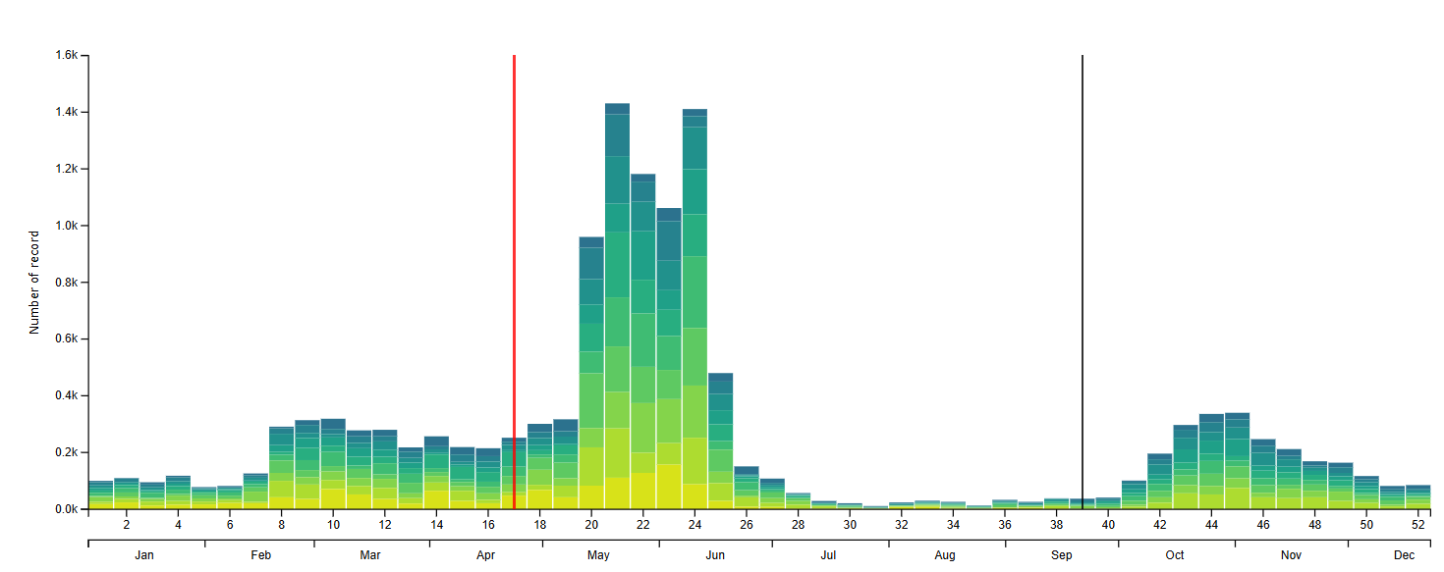
Model to estimate probability of origin
model solely to distinguish whether shot birds are local or not
feathers of known origin to calibrate relationship between δ²H_{feather} and δ²H_{rain}
overlayed forest layer with woodcock range map and sampled possible distribution of rainwater δ²H_{rain} from across the plausible woodcock distribution
for each shot woodcock, specified δ²H_{feather} distribution for shooting location
estimated probability that shot woodcock δ²H_{feather} comes from local distribution
included abundance phenology and migration probability as prior for local origin

Slide 15
Results – the basic raw numbers
Ringed birds | Total | 472
 | Breeding season (May to August) | 99
 | Migration season (March, April and September to Decermber) | 373
Equipped | Total | 85
 | VHF radio transmitters | 55
 | Satellite transmitters | 30
Found dead | Total | 10
 | Predation | 9
 | Unknown | 1
Shot | Total | 97
 | Switzerland | 8
 | North-eastern France | 30
 | Rest of France | 39
 | Spain / Portugal | 17
 | Russia | 3
Never re-recorded |  | 300
21%
77%

Slide 16
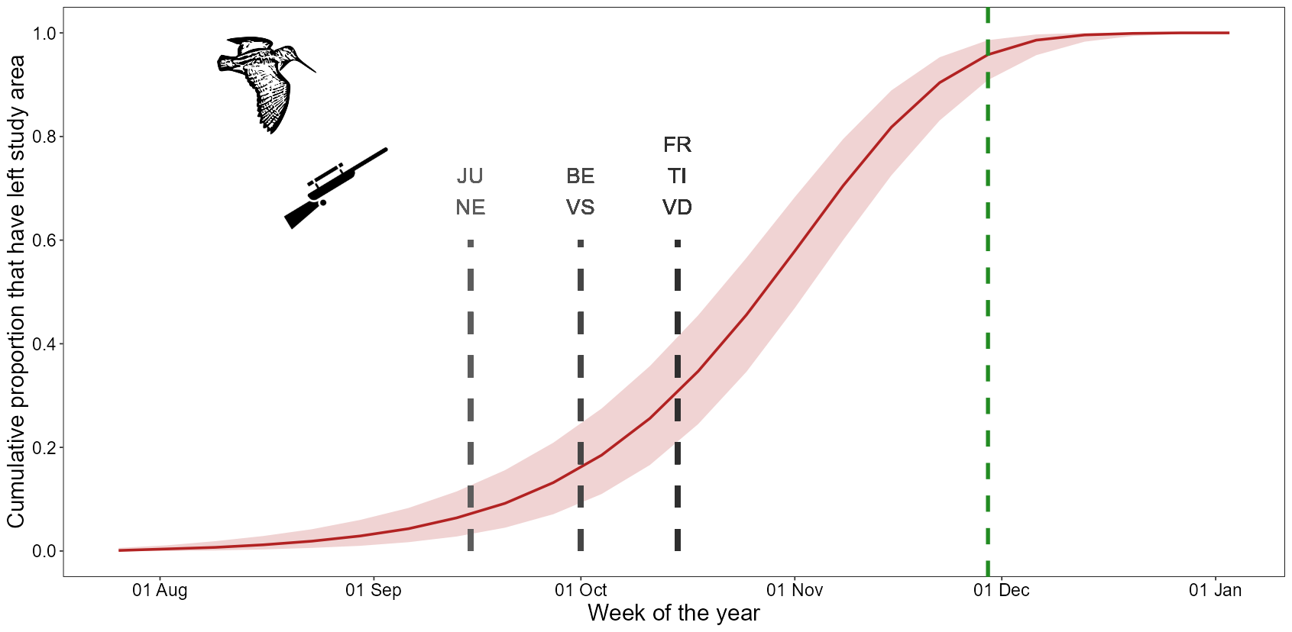
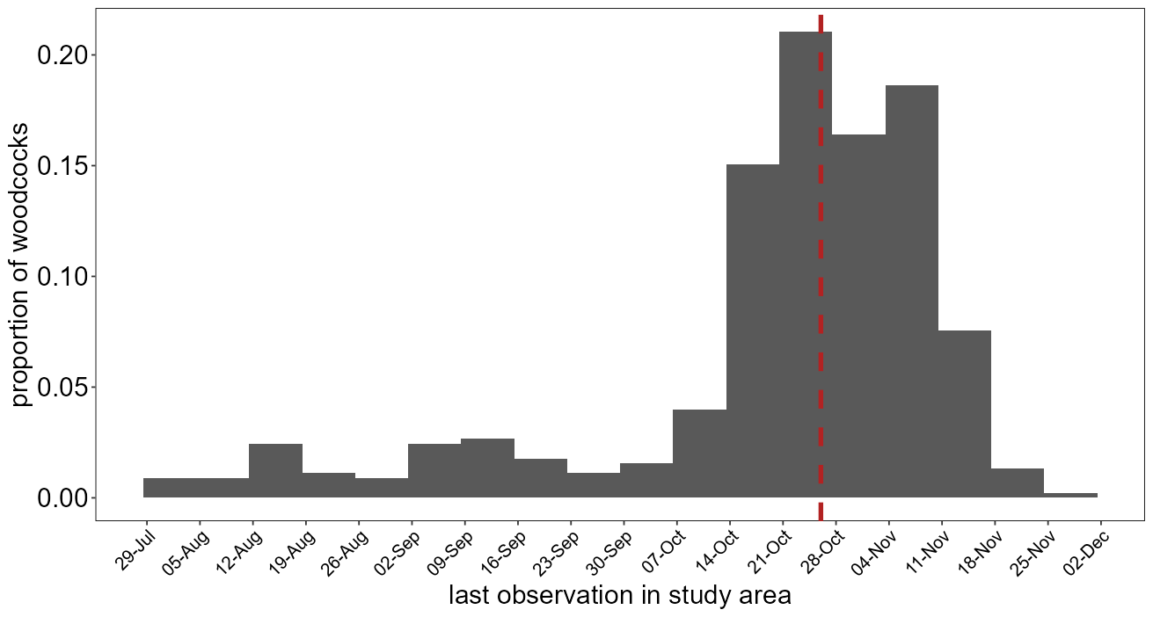
Woodcocks depart late in autumn
based on VHF and GPS tracking of 467 bird-years in Swiss forests
median last observation day is 26 October (middle of hunting season)
65 - 94% present at beginning of hunting season (varies by canton)

Slide 17
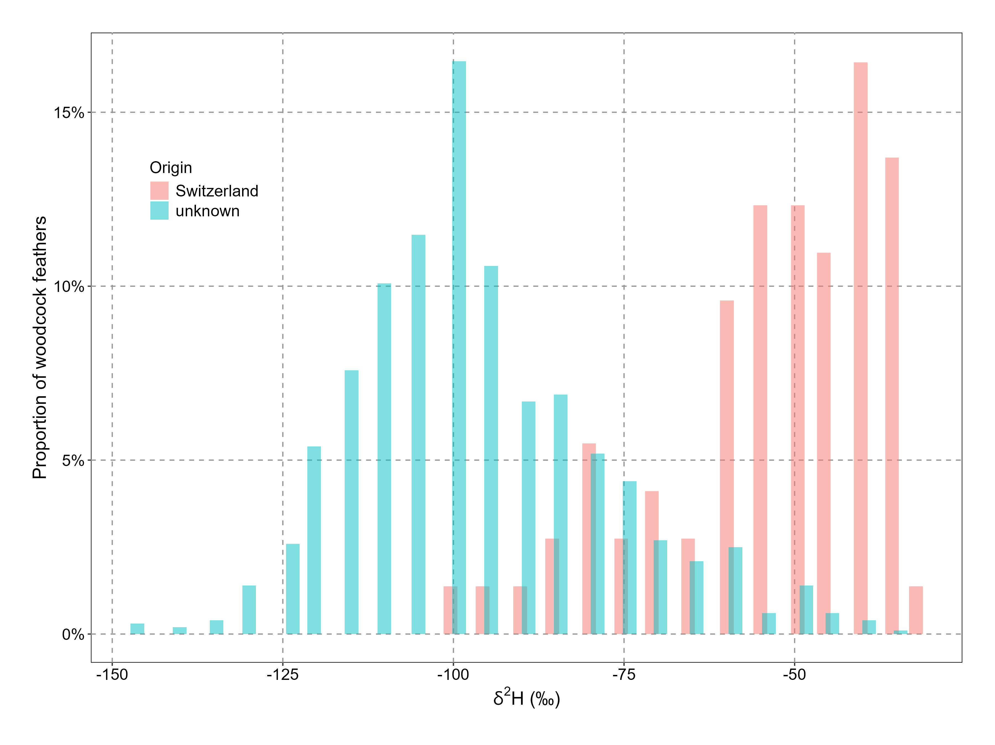
Hydrogen isotope ratios of woodcock feathers
wide range of δ²H_{feather} for shot birds of unknown origin (blue)
substantial overlap with δ²H_{feather} from Swiss birds (red)

Slide 18
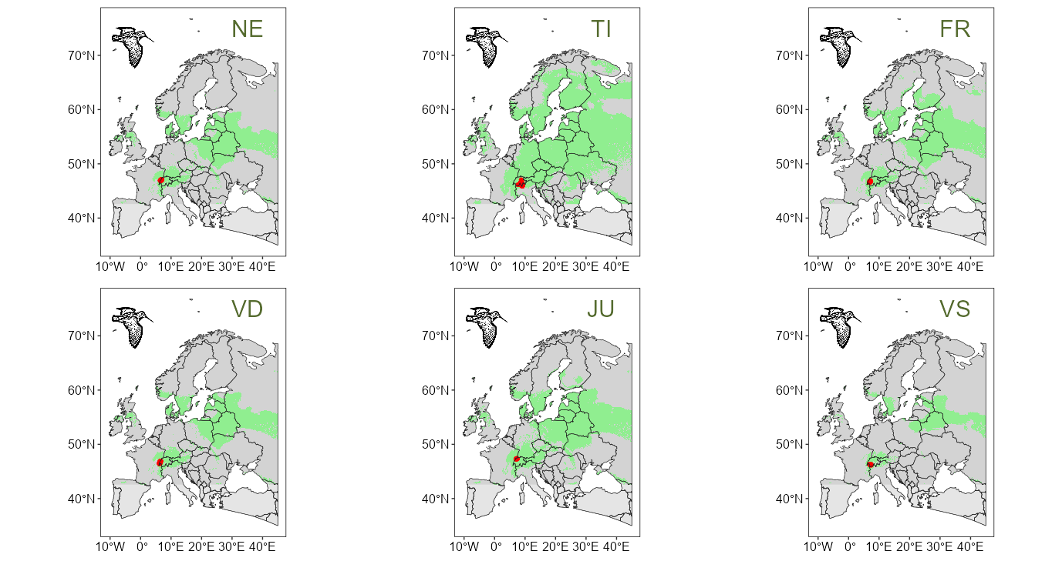
Isotopic ambiguity of origin
maps of Europe where δ²H_{feather} would be indistinguishable from Swiss birds
birds originating from those areas would be considered ‘local’ in our model

Slide 19
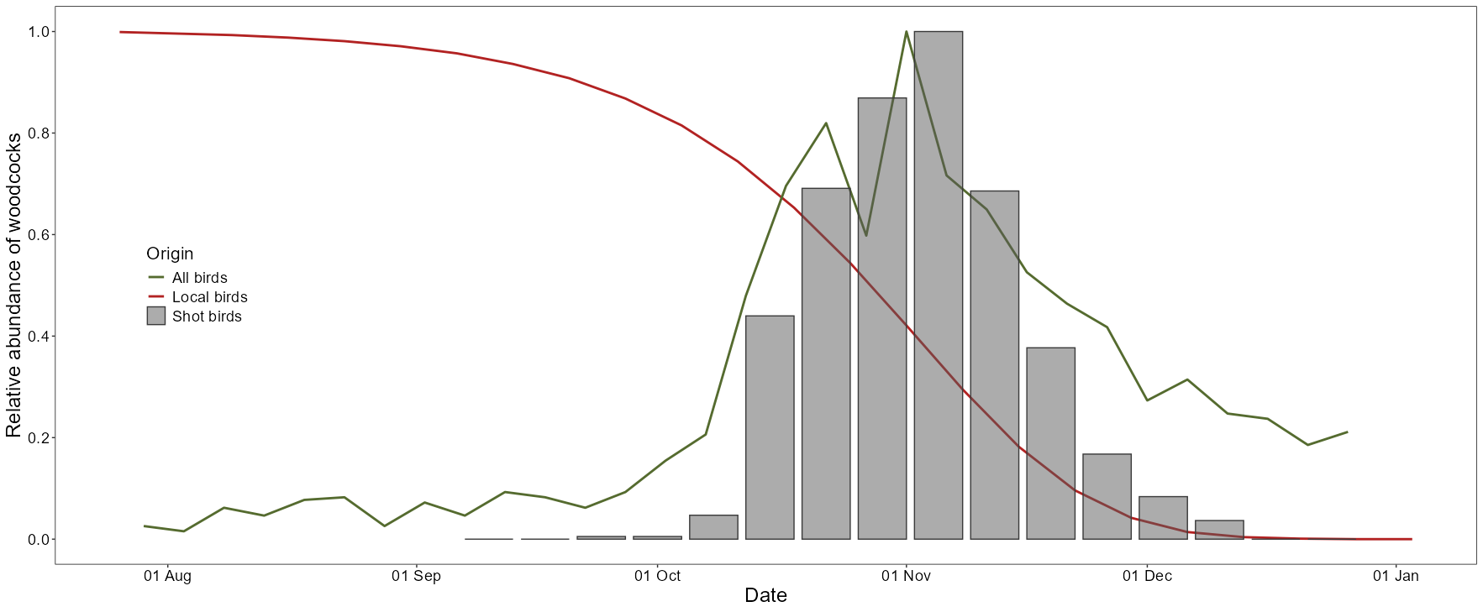
Including time of shooting to improve assignment
estimated probability of local birds to still be present (red line)
relative index reflects overall abundance (including non-local birds (green line)

Slide 20
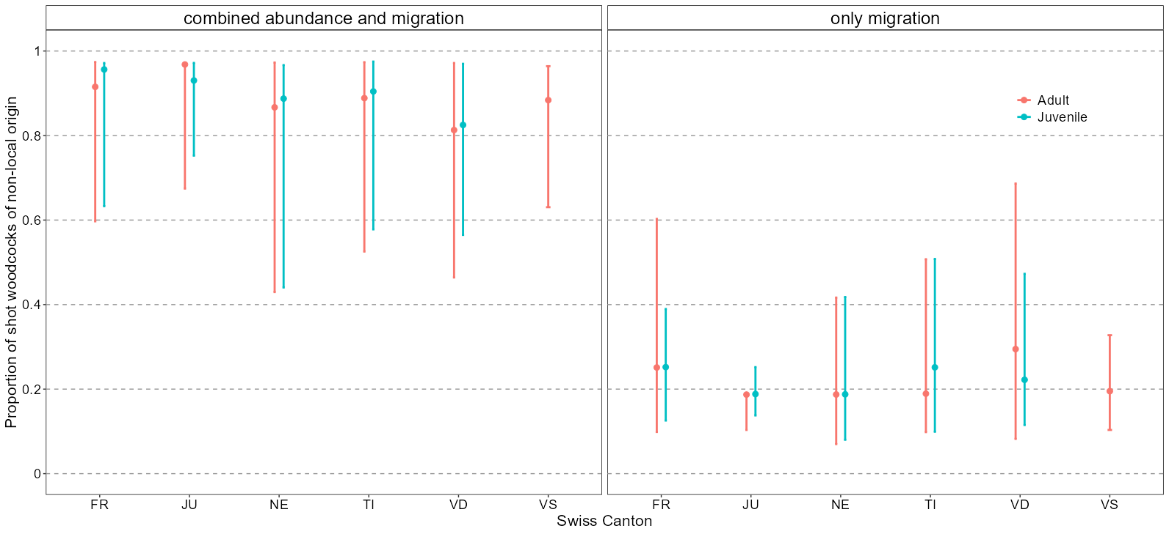
Proportion of shot woodcocks of non-local origin
based on 842 individuals of unknown origin (9% of total Swiss hunting bag)
estimated proportion mostly dependent on prior information

Slide 21
Extrapolation of hunting mortality
breeding population 2000 – 8000 birds
annual hunting bag 1820 shot woodcocks (average 1985 – 2024)
we estimated 0.2 - 54% of the shot birds to be local (= 36 - 983 woodcocks)
in our sample 28.8% of shot woodcocks were adult (=10 - 283 adult woodcocks)
represent 0.1 - 14% of Swiss breeding population
small proportion compared to hunting mortality elsewhere (only 8% of shot woodcocks were shot in Switzerland)

Slide 22
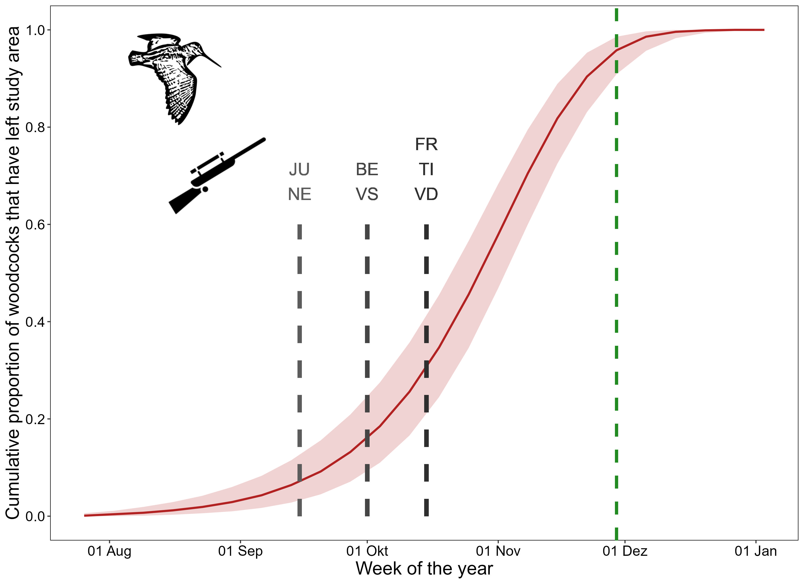
We cannot determine origin of shot woodcocks
assignment of shot woodcocks to origin is unreliable
timing suggests that most Swiss woodcocks are exposed to hunting
hydrogen isotopes too variable and inconclusive to infer origin
huge effect of abundance prior indicates overriding effect of dilution
if we want to protect local woodcocks then delayed start of hunting season would be the simplest option (after 25 November)

Slide 23
Conclusions
shooting migratory birds may be desirable from a Swiss perspective, but may harm other populations we know very little about
woodcock shooting is a ‘sport’ in Switzerland – nobody needs them as food
hunting in Switzerland not greatest source of mortality, but one that could be removed by national legislation
crazy proposition: make it a real sport – allow hunting only without dogs, with a handnet, and on the condition that bird is released live and well

Slide 24
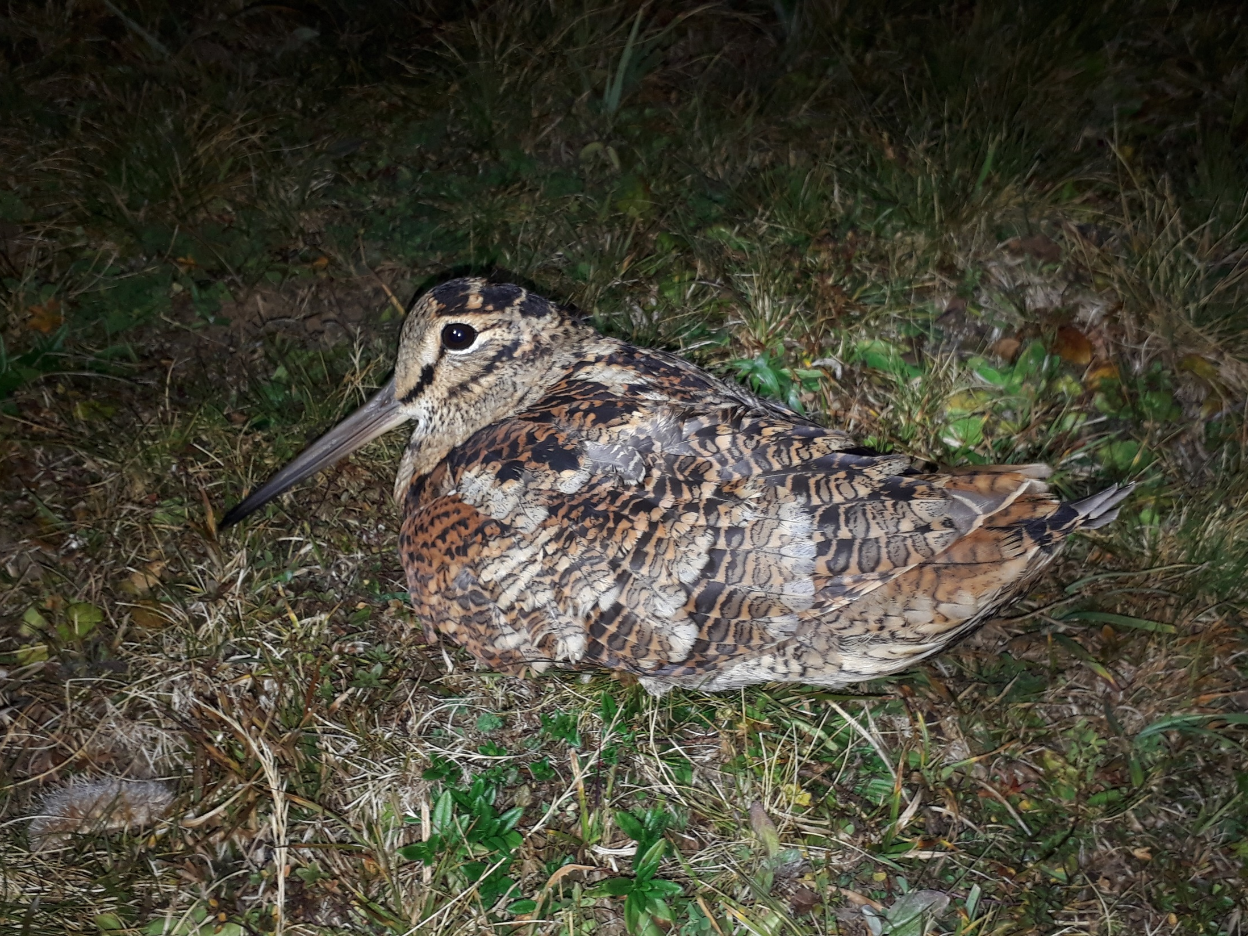
Thank you
Lorenza Marconi, Jérôme Gremaud, Romain Fürst, Henri Descombes, Yann Fragnière, Nicolas Pasquier, Yann Rime, Florence Bovay, Jan Naef, Sandrine Seidel, Charlotte Warburton, Samuel Jordan, Henri-Armand Meister, Yves Lanoir, Francis Anker, Victor Ulrich, Thierry Barbier, Giuliano Viali, Stéphane Regazzoni
Christian Voigt, Stephanie Kramer-Schaadt,
Thierry Bohnenstengel, Benjamin Homberger

